Slide 1
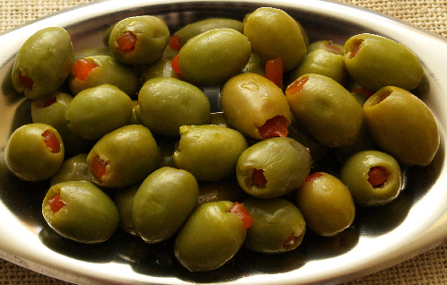
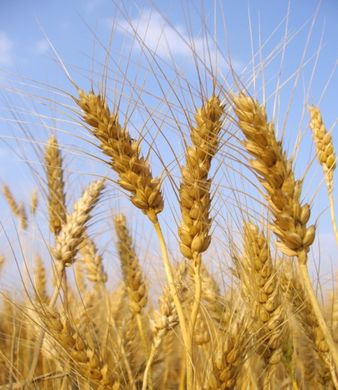
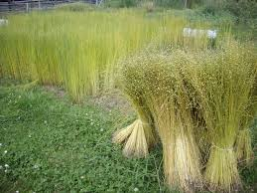
MAIN OCCUPATION OF GREEKS
Agriculture and farming were the main occupations of the people . The majority of the people made their living from farming . The important crops were olives, wheat and flax.

Slide 2
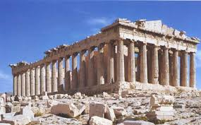
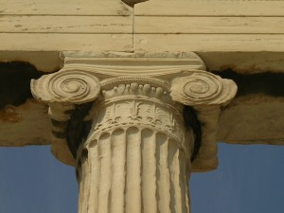
ARCHITECTURES IN GREEK CIVILISATION
The temple of ancient Greece providing illustration of Greek art and architecture. Parthenon temple of Goddess Athena built on the Acropolis is the finest example of Greek Architecture.

